Slide 1
BMEG3105-TUT6: HW1 & eigenvector
Qinze YU
Thursday, October 13, 2022
qzyu22@cse.cuhk.edu.hk
Department of Computer Science and Engineering (CSE)
The Chinese University of Hong Kong (CUHK)

Slide 2
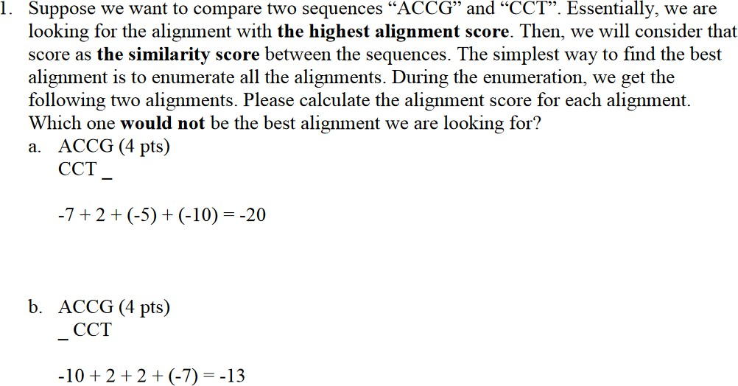
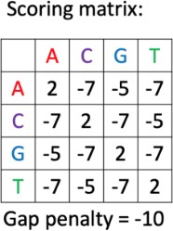
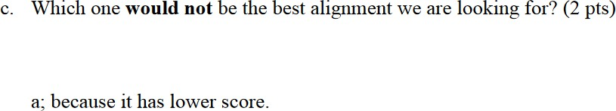
Sequence aliment & DP

Slide 3
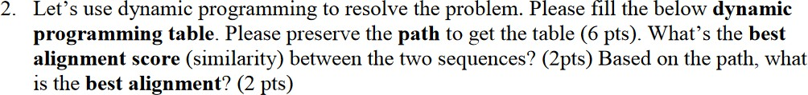
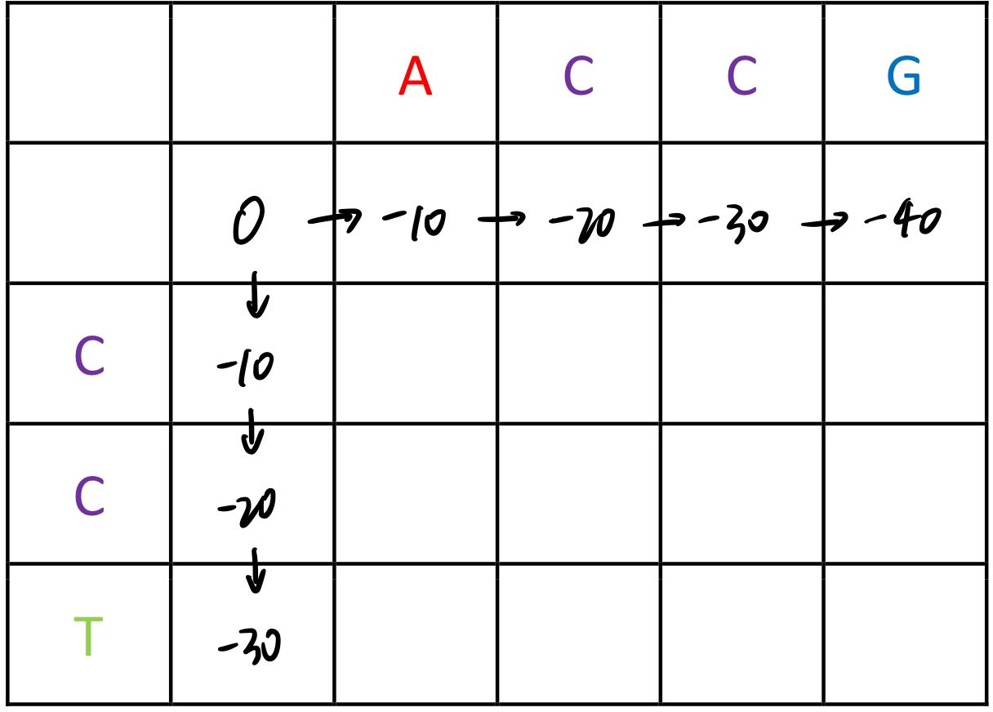
Sequence aliment & DP

Slide 4
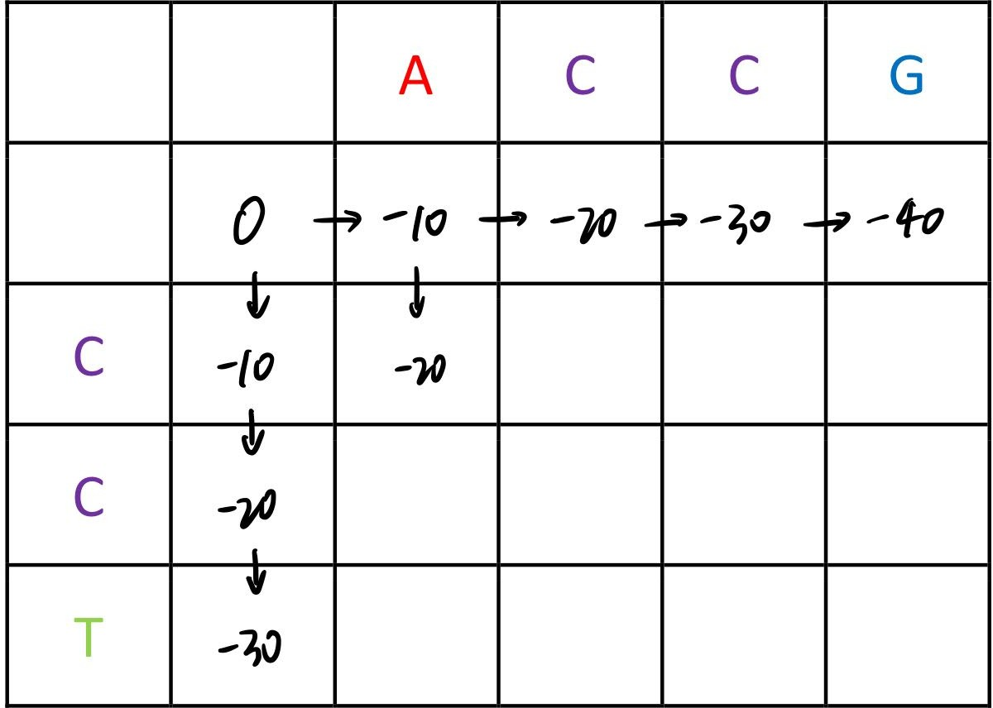

Sequence aliment & DP

Slide 5
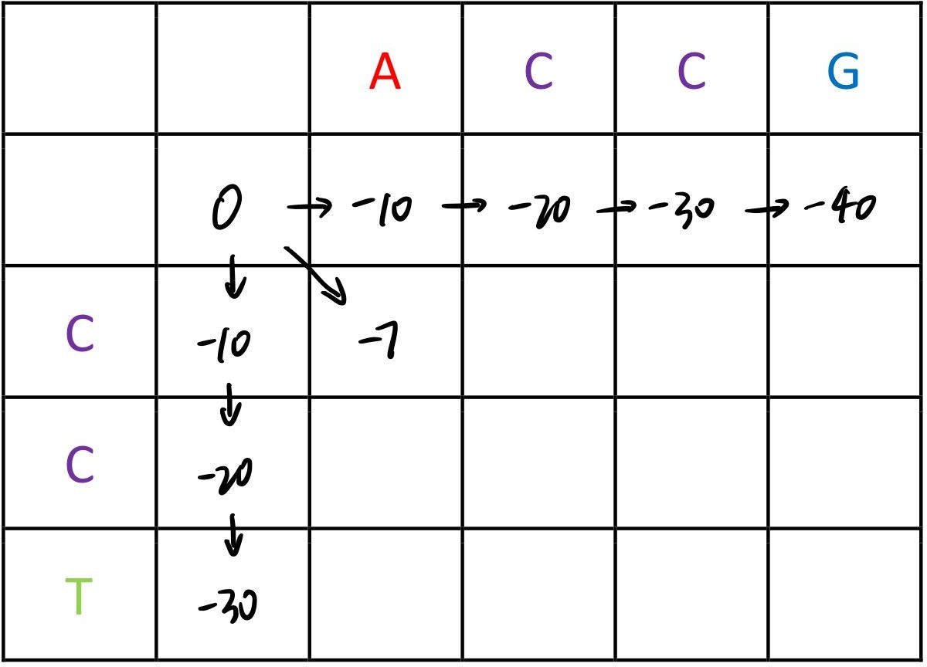

Sequence aliment & DP

Slide 6
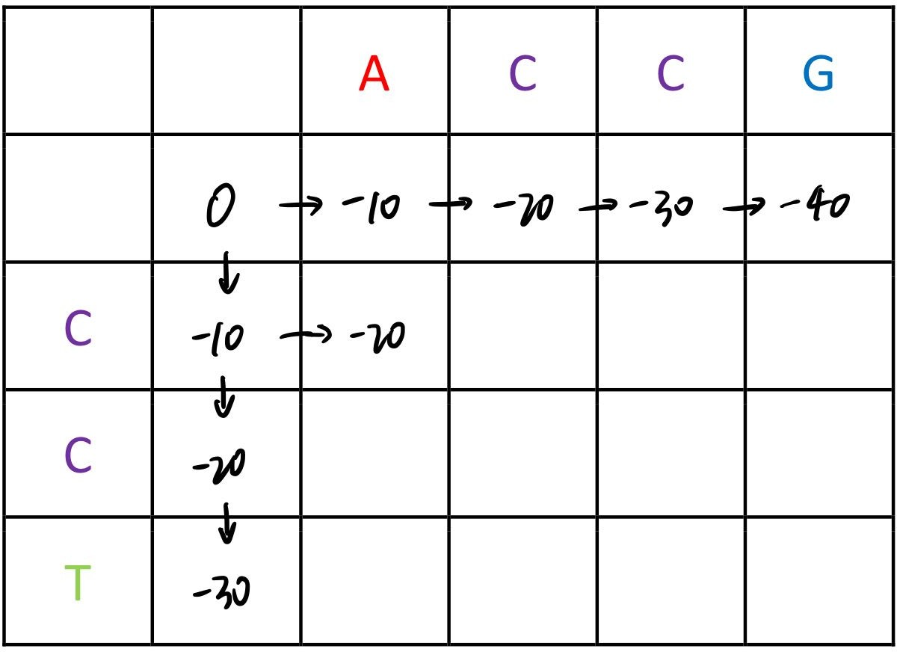

Sequence aliment & DP

Slide 7
Sequence aliment & DP

Slide 8
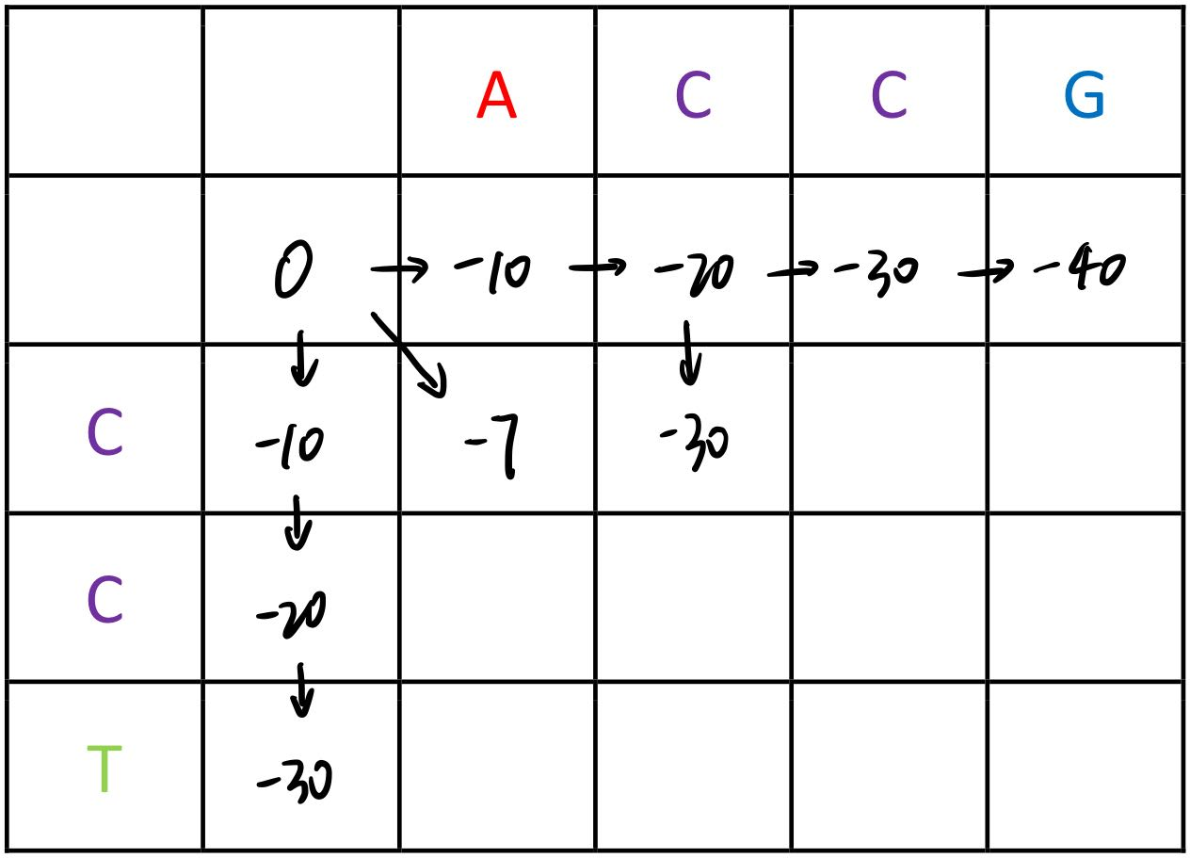
Sequence aliment & DP

Slide 9
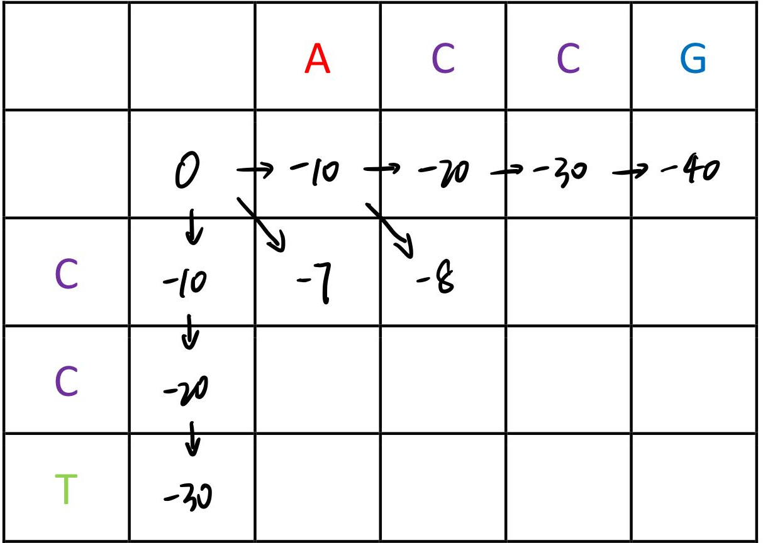
Sequence aliment & DP

Slide 10
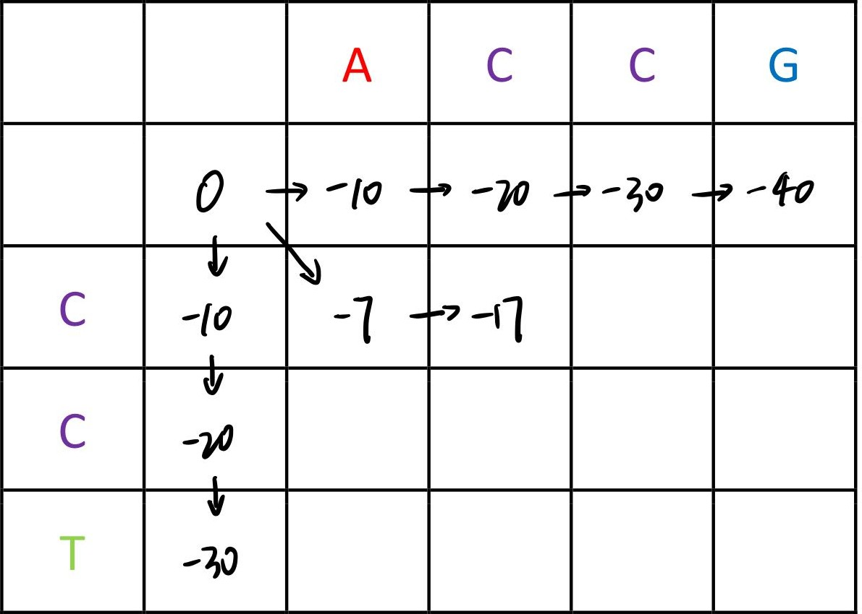
Sequence aliment & DP

Slide 11
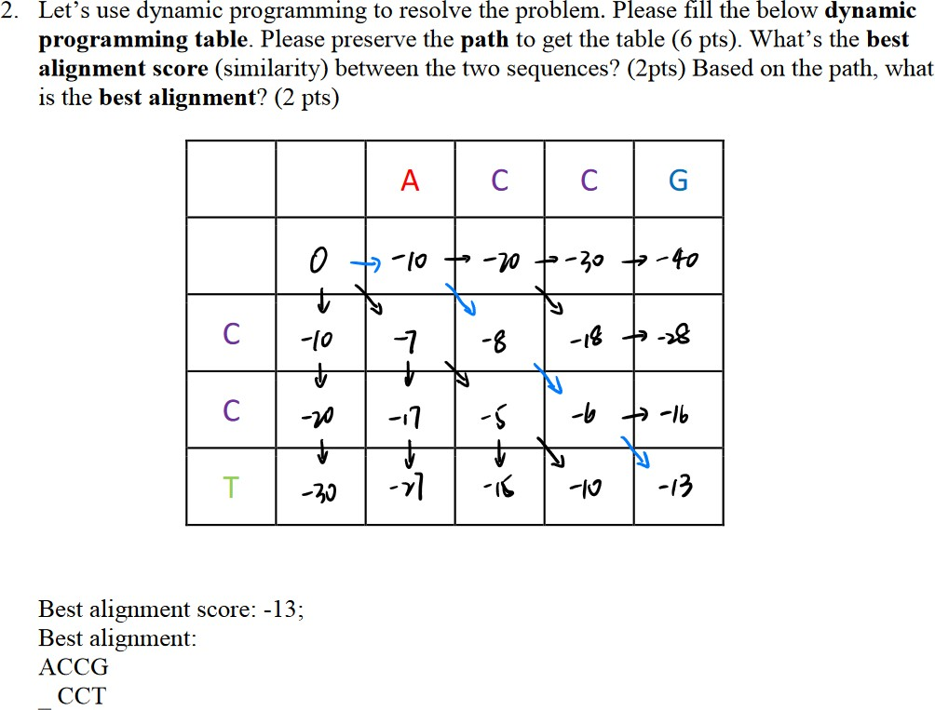
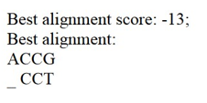
Sequence aliment & DP

Slide 12
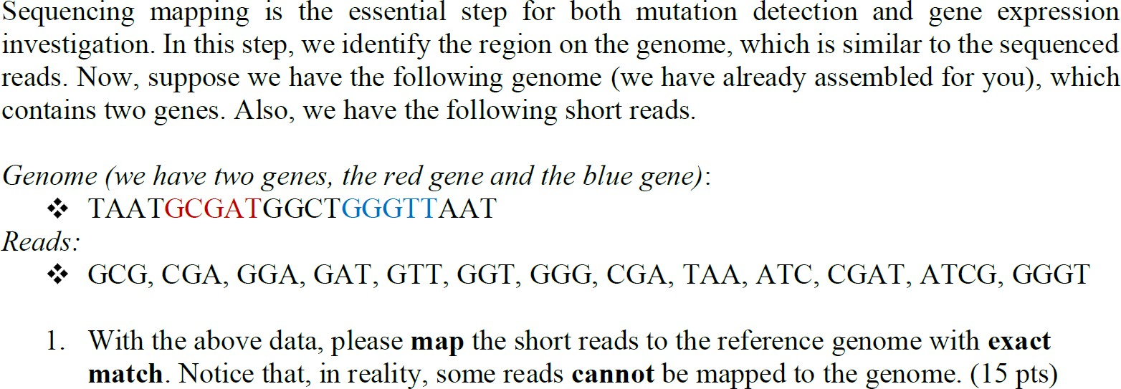
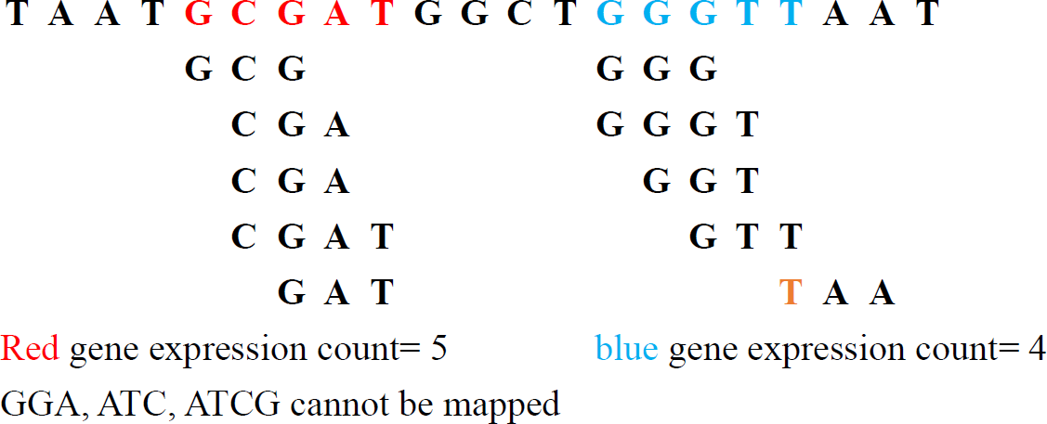
Sequence assembly & Sequence mapping
“TAA” can’t be fully mapped to the gene
So only 4 reads can be mapped to the blue gene

Slide 13
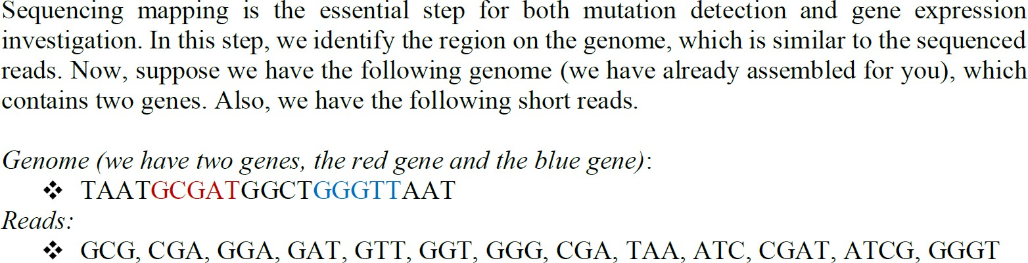
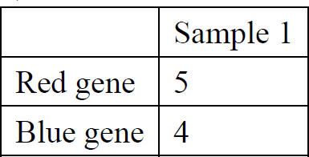
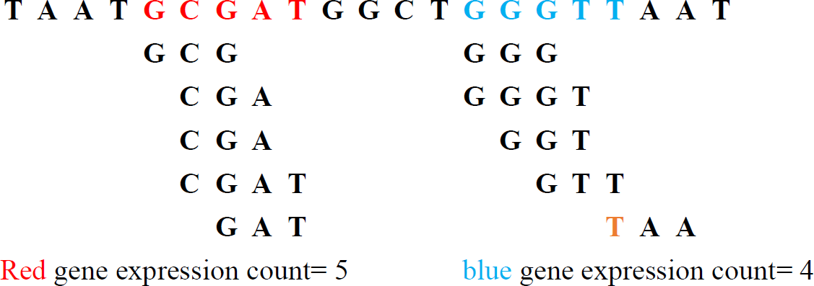
Sequence assembly & Sequence mapping

Slide 14
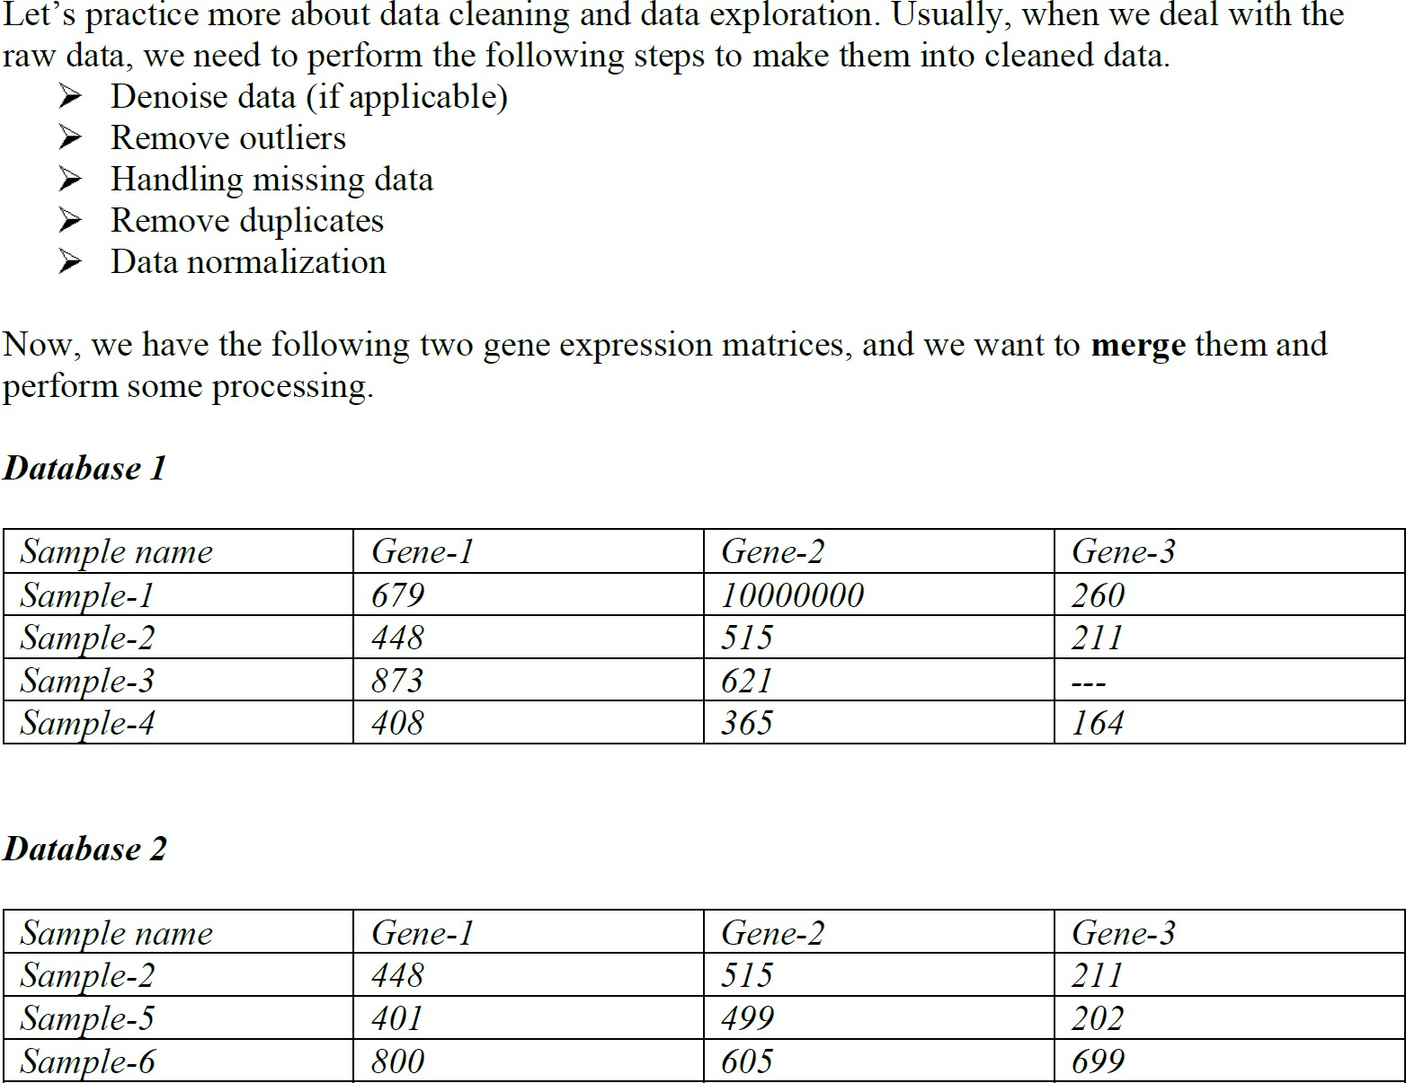
Data cleaning & Data visualization

Slide 15
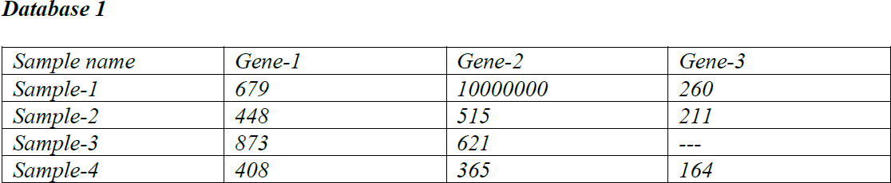
Data cleaning & Data visualization
Both sample-wise and gene-wise are ok. Just Make sure you normalize it correctly.
Sample-wise (row): It can show the difference among the 3 gene expressions
Gene-wise (column): It can show the difference among these samples
In practice, the way to normalize the data depends on your needs

Slide 16
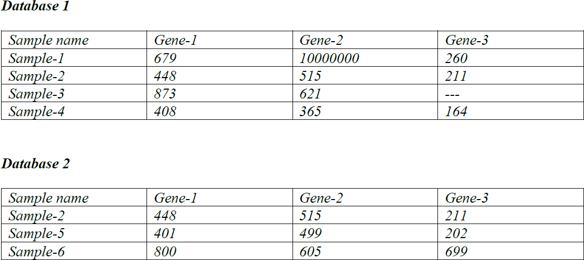
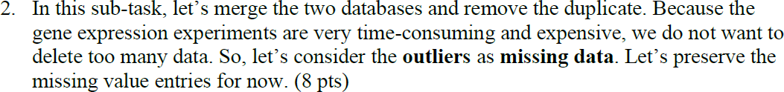
Data cleaning & Data visualization
Duplicate

Slide 17
Data cleaning & Data visualization
Outlier

Slide 18
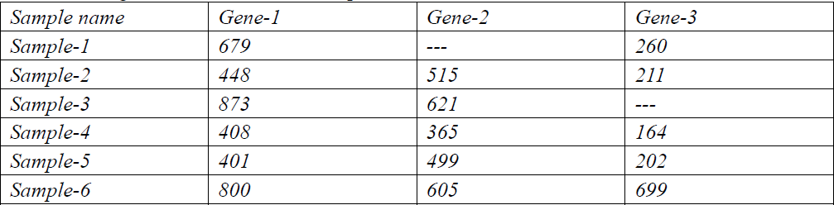
Data cleaning & Data visualization

Slide 19
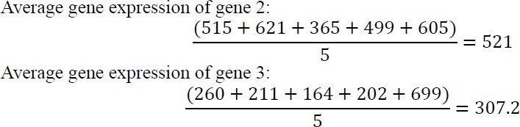
Data cleaning & Data visualization
First, use the average gene expression value in other samples for the missing value

Slide 20
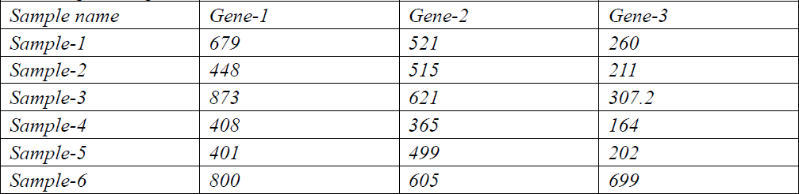
Data cleaning & Data visualization
Now you can normalize the data for each row or column in different ways

Slide 21
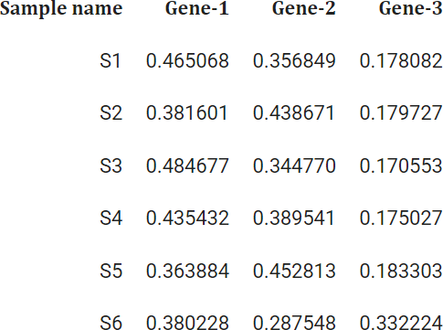
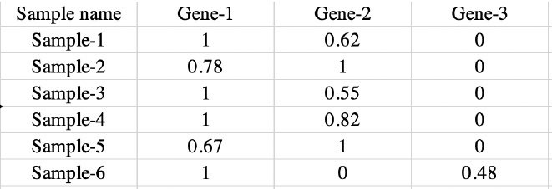
Data cleaning & Data visualization
Examples:
Sample-wise: (row)

Slide 22
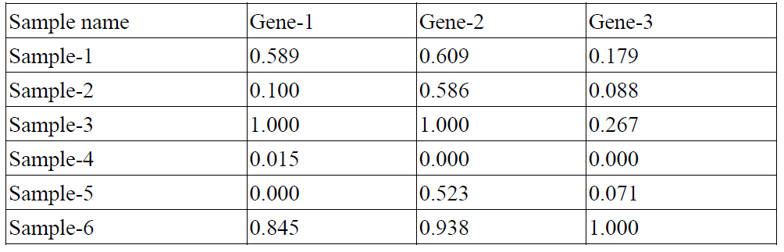
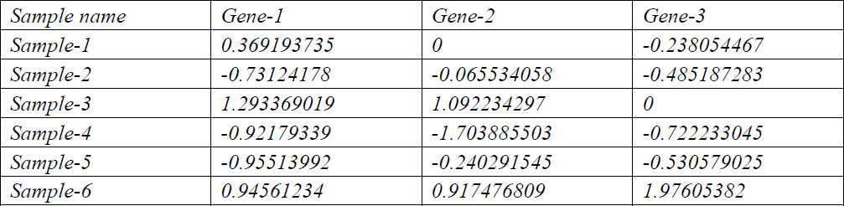
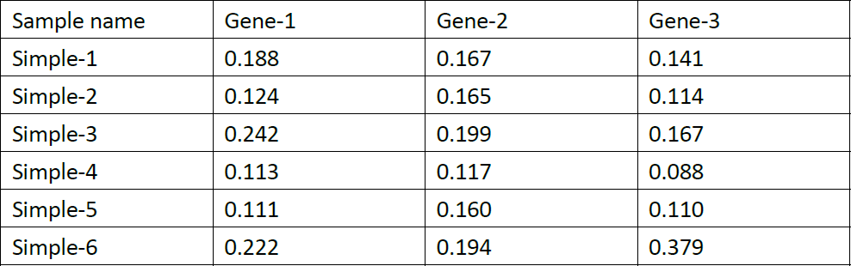
Data cleaning & Data visualization
Examples:
Gene-wise: (column)

Slide 23
Eigenvector & Eigenvalue
In linear algebra, an eigenvector of a square matrix is a vector that does not change its direction under the associated linear transformation.
In other words – If V is a vector that is not zero, then it is an eigenvector of a square matrix A if AV is a scalar multiple of V.
In equation, it is AV = λV

Slide 24
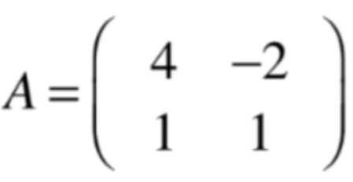
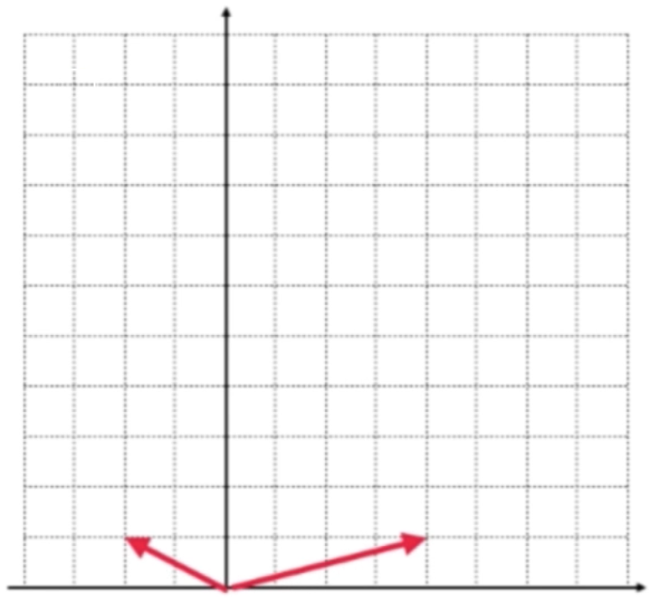
Eigenvector & Eigenvalue
Example:
We can think of it as a basis in the two dimensions plane
as follows:

Slide 25
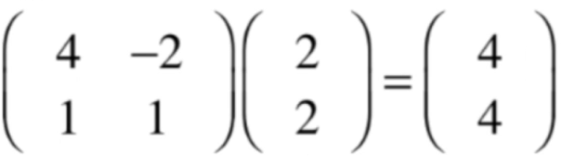
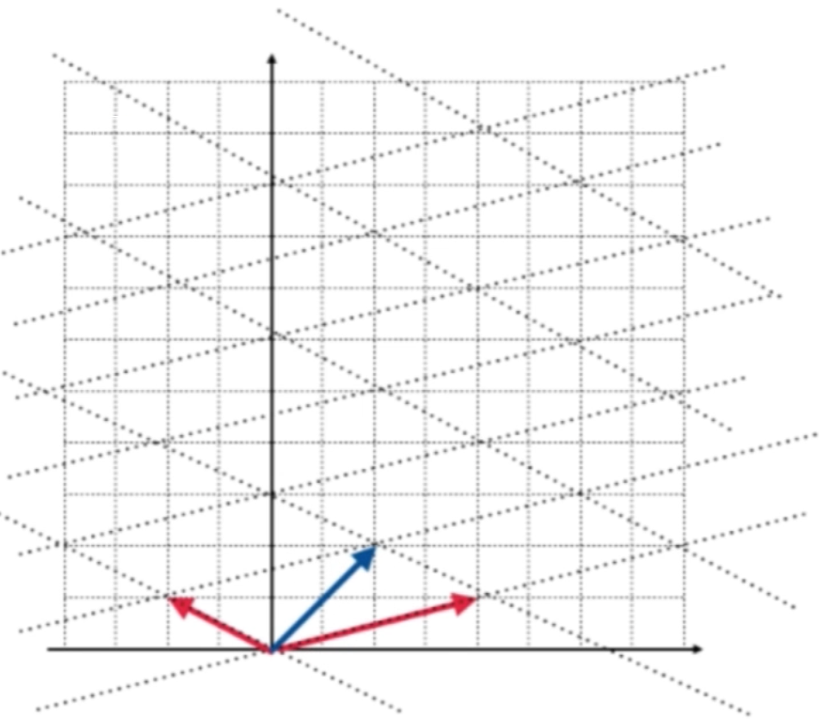
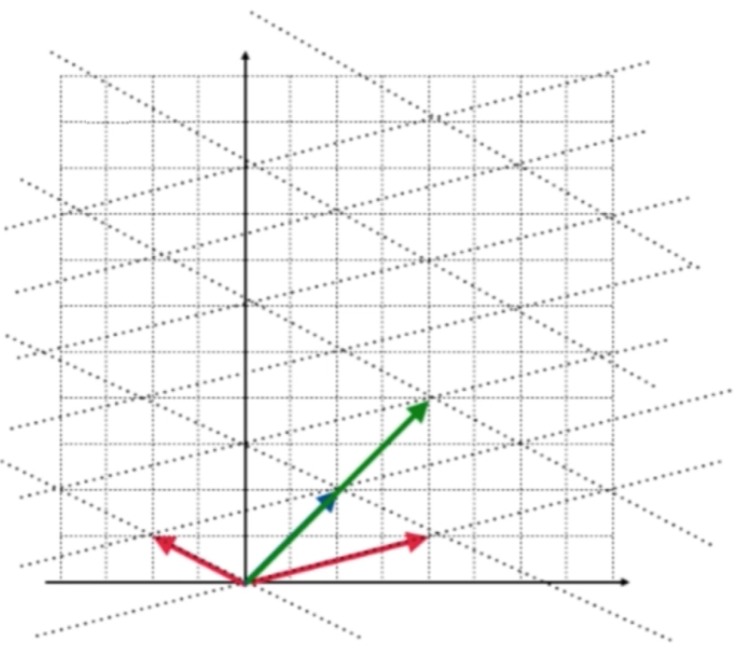
Eigenvector & Eigenvalue
Example:
The vector doesn't change direction after the transformation

Slide 26
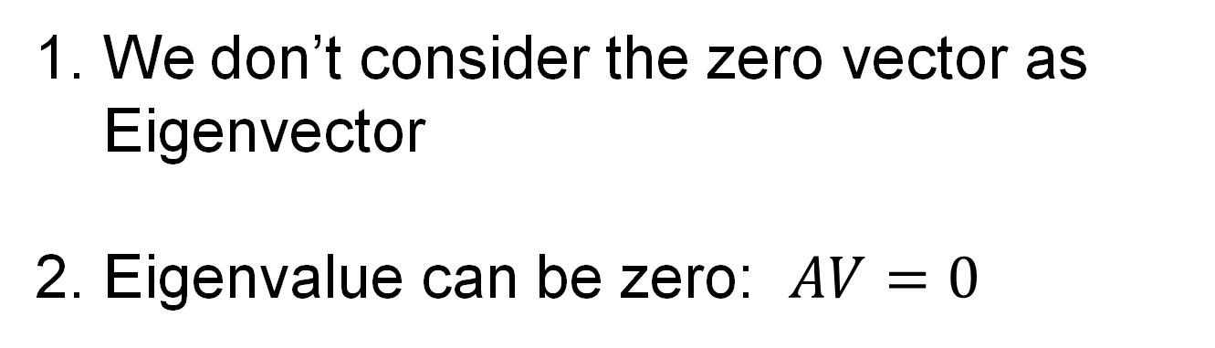
Eigenvector & Eigenvalue
How to get Eigenvector & Eigenvalue of a matrix?
We don’t consider the zero vector as Eigenvector
Eigenvalue can be zero: $AV=0$

Slide 27

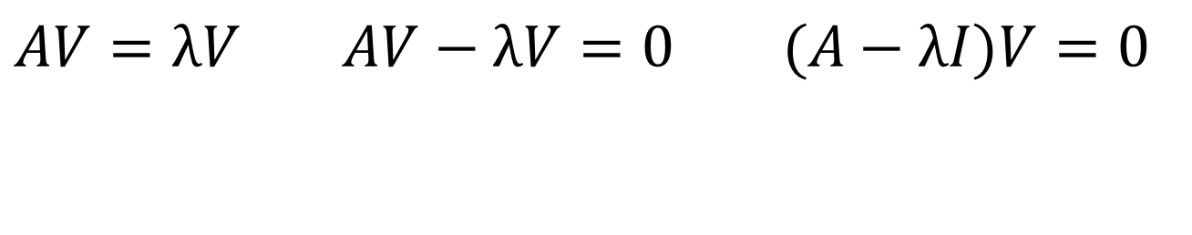
Eigenvector & Eigenvalue
How to get Eigenvector & Eigenvalue of a matrix?
$AV=λV$ $AV−λV=0 (A−λI)V=0$
$det(A−λI)$=0

Slide 28
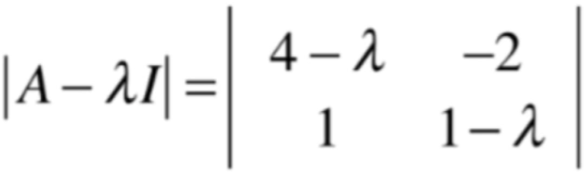

Eigenvector & Eigenvalue
Example:
$det(A−λI)$=0

Slide 29
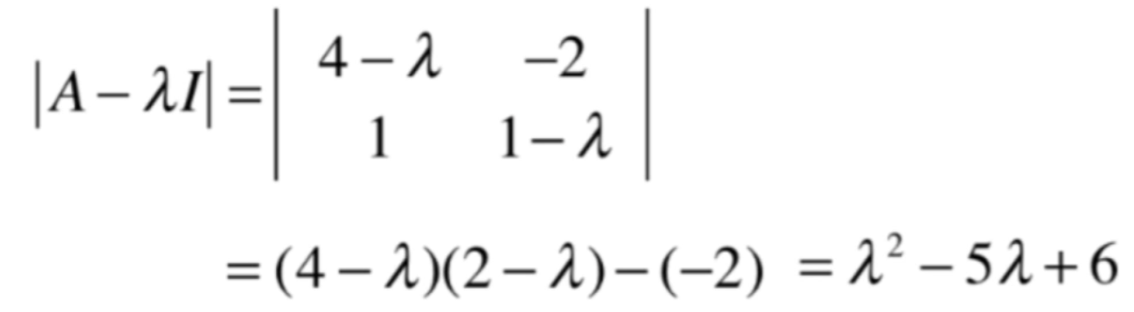

Eigenvector & Eigenvalue
Example:
$det(A−λI)$=0
$${\text{λ}}_{1}=2, {\text{λ}}_{2}=3$$

Slide 30
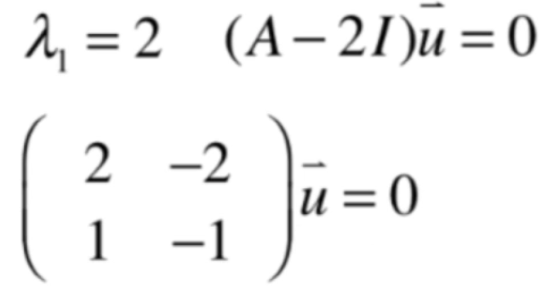
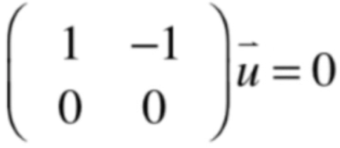
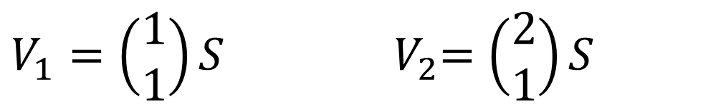
Eigenvector & Eigenvalue
Example:
$det(A−λI)$=0
$V_{1}=\left(\begin{matrix}1 \\ 1\end{matrix}\right)S$ ${ V}_{2}=\left(\begin{matrix}2 \\ 1\end{matrix}\right)S$

